Slide 1

Fish Species Selection and Growth Monitoring for Sustainable Aquaculture
Group Members
Sajid Ali(21p-8023)
Muhammad Nauman (21P-8045)
Ammar Raza (21P-8004)
Project Supervisor
Sir Usman Wajid

Slide 2
Introduction
Aquaculture is the farming of fish, crustaceans, and aquatic plants in controlled environments to meet global seafood demand. It supports food security and reduces pressure on wild fish stocks.
Aquaculture provides us with:
Importance of water quality
Species Recommendation
Growth Optimization
Sustainability
Efficient Resource Use
Disease Detection

Slide 3
Problem Statement
Aquaculture faces challenges such as suboptimal fish growth due to traditional methods, difficulties in choosing the right fish species, and resource wastage from poor water management. Inadequate disease detection tools increase the risk of outbreaks, which impacts fish health and overall productivity.

Slide 4
Objectives
The objective of this project is to develop an advanced aquaculture system that includes a fish type classification model, size and growth monitoring, behavior tracking, and disease detection to improve fish farming practices.
The project aims to integrate these modules with sensors and existing systems to create a reliable solution that ensures fish health and productivity. Real-time alerts and a user-friendly web/app interface will be developed to help users monitor fish conditions, receive notifications, and take timely actions.

Slide 5
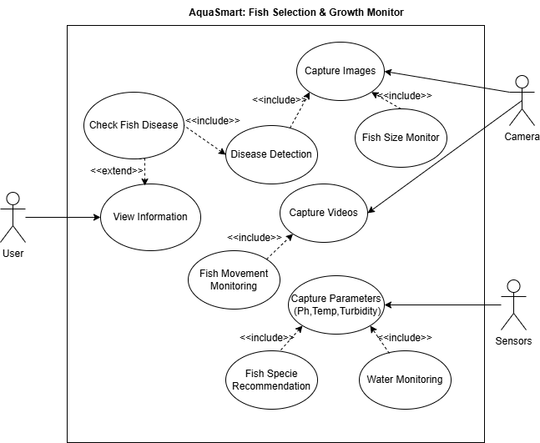
UML Diagram
Use Case Diagram
Fig 1.0: Use Case Diagram

Slide 6
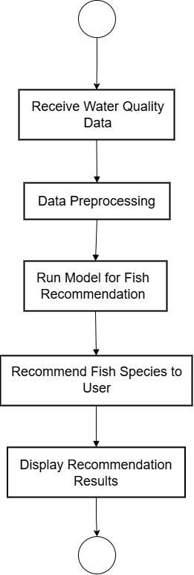
UML Diagram
Fish Recommendation
Fig 2.1: Activity Diagram

Slide 7
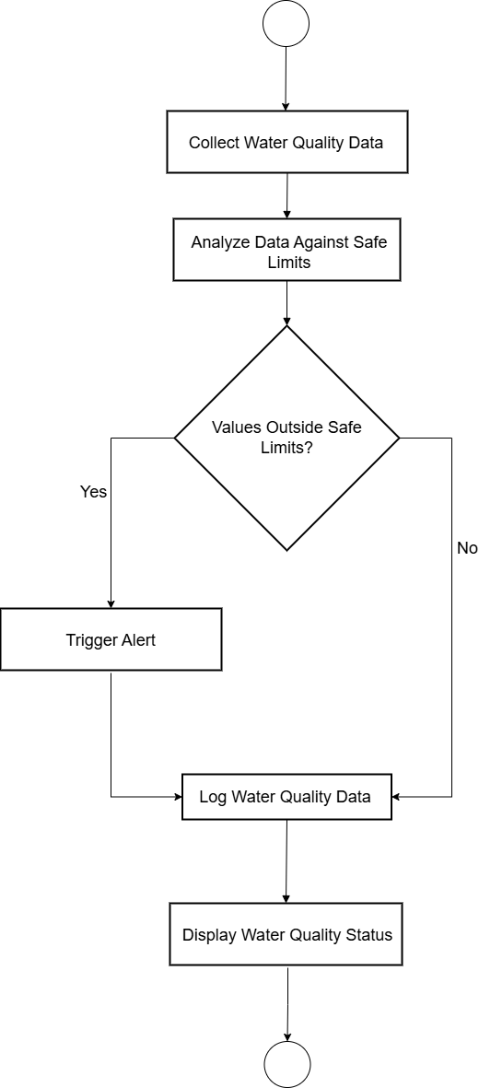
UML Diagram
Water Quality Monitoring
Fig 2.2: Activity Diagram

Slide 8
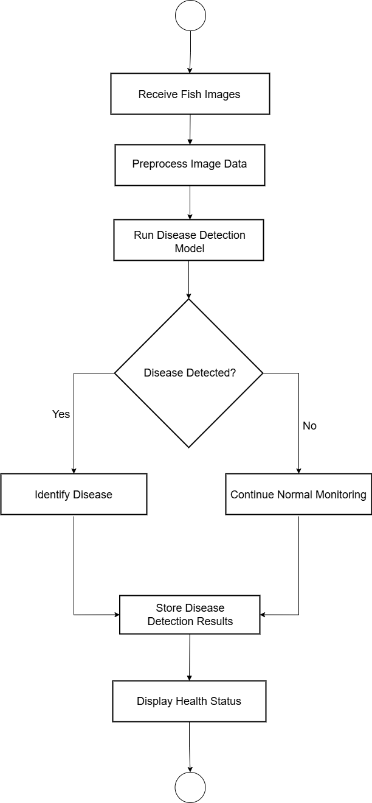
UML Diagram
Disease Detection
Fig 2.3: Activity Diagram

Slide 9
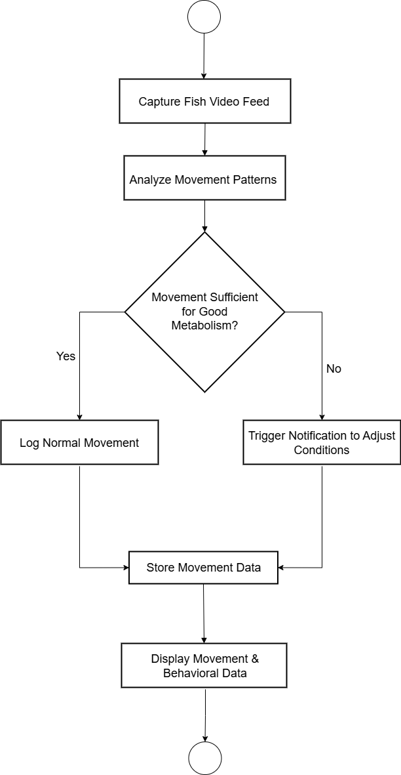
UML Diagram
Movement Monitoring
Fig 2.4: Activity Diagram

Slide 10
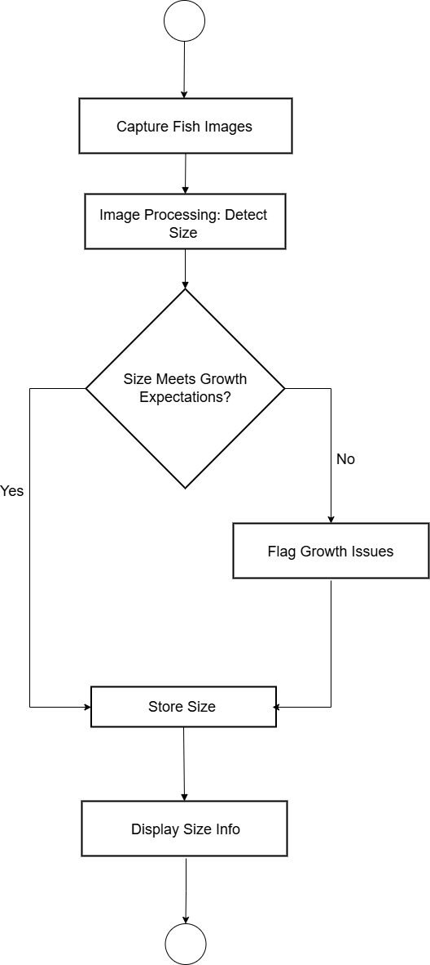
UML Diagram
Size Monitoring
Fig 2.5: Activity Diagram

Slide 11
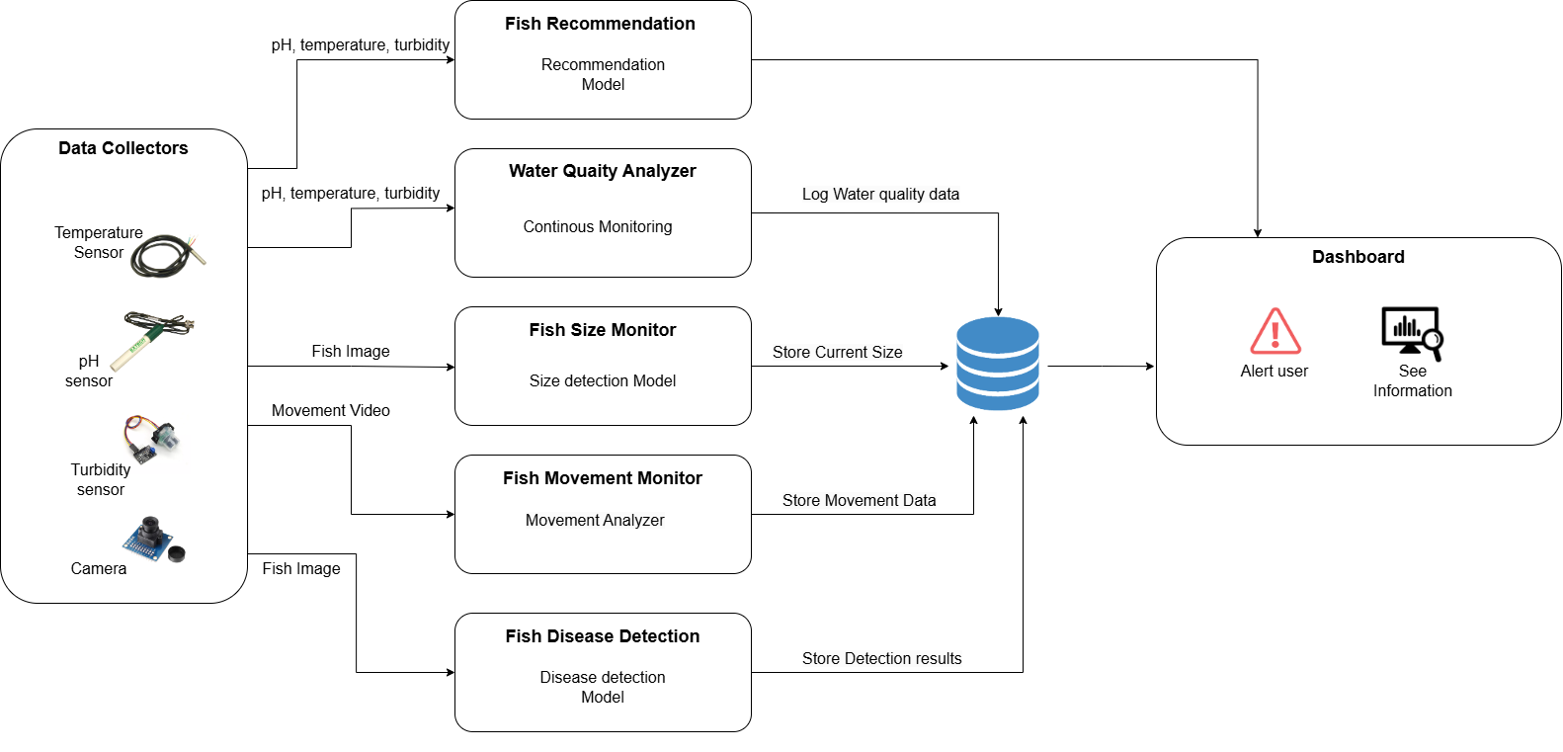
ARCHITECTURE Diagram
Fig 3: Architecture Diagram

Slide 12
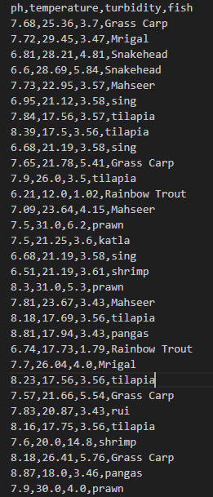
Dataset
Fish Recommendation dataset
Total Observations:
The dataset contains 1051 rows, representing different environmental conditions and their associated 13 types of fishes.
The dataset is obtained from Kaggle.
Features:
pH: Indicates the pH level of water, which measures its acidity or alkalinity (numeric).
Temperature: Represents the temperature of the water, likely in Celsius (numeric).
Turbidity: Describes the clarity of water, measuring the level of suspended particles (numeric).
Fish: The type of fish associated with the given environmental parameters (categorical).
Fig 4: Classification Dataset

Slide 13
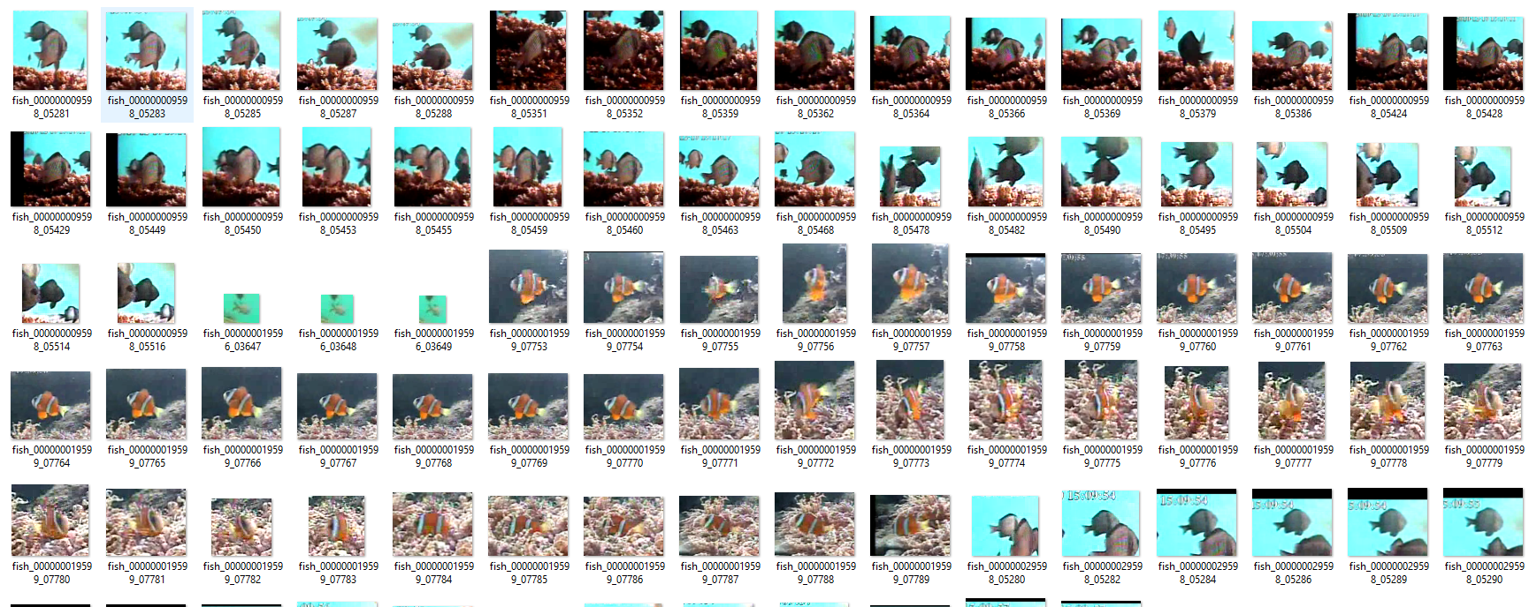
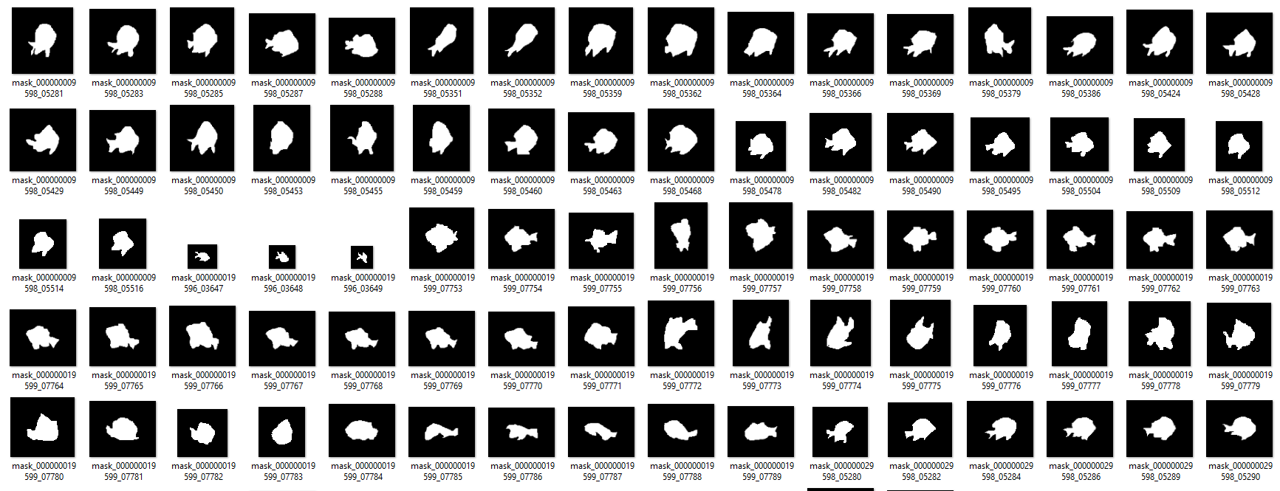
Dataset
Size Measuring dataset
Dataset Used: Kaggle's Fish Recognition Ground-Truth Data
Total Images: 27,370 fish images
Total Masks: 27,370 corresponding masks
Classes:
Fish
Masks
Task: Binary classification and segmentation
Focus: Fish detection in water environments
Fig 5: Detection Dataset

Slide 14
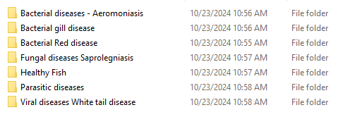
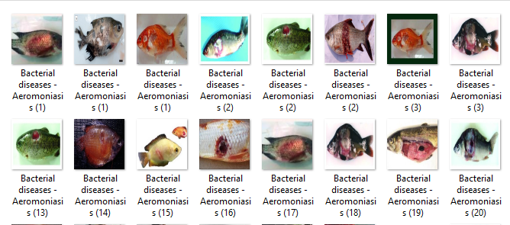
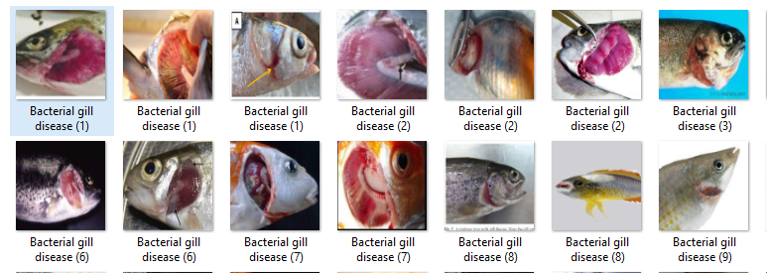
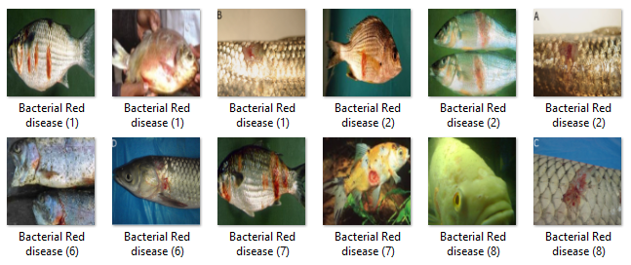
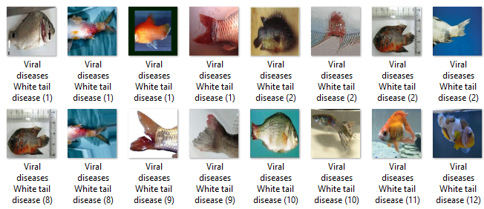
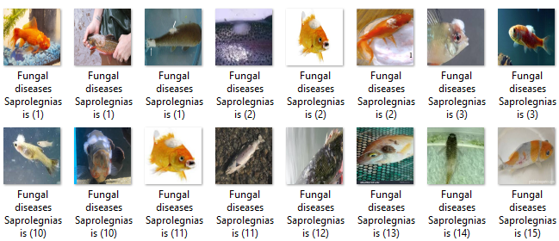
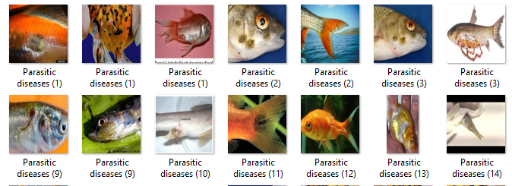
Dataset
Disease Detection Dataset
We have the dataset that are used for disease detection in the fish.
Total Classes: 7 classes
Training Set: 250 images per class
Test Set: 100 images per class
Image Size: 240x240 pixel
Total images: 2450 images
Fig 6: Disease Classes
Fig 7: Different Diseases

Slide 15
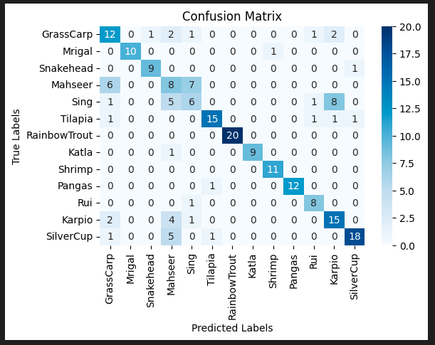
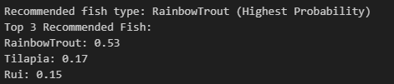
Classification Model
Making the classification model by using random forest.
Accuracy: 72.6%
Avg. Precision: 0.73
Avg. Recall : 0.73
Avg. f1-score: 0.72
Fig 8: Classification Confusion Matrix
Fig 9: Classification sample output

Slide 16
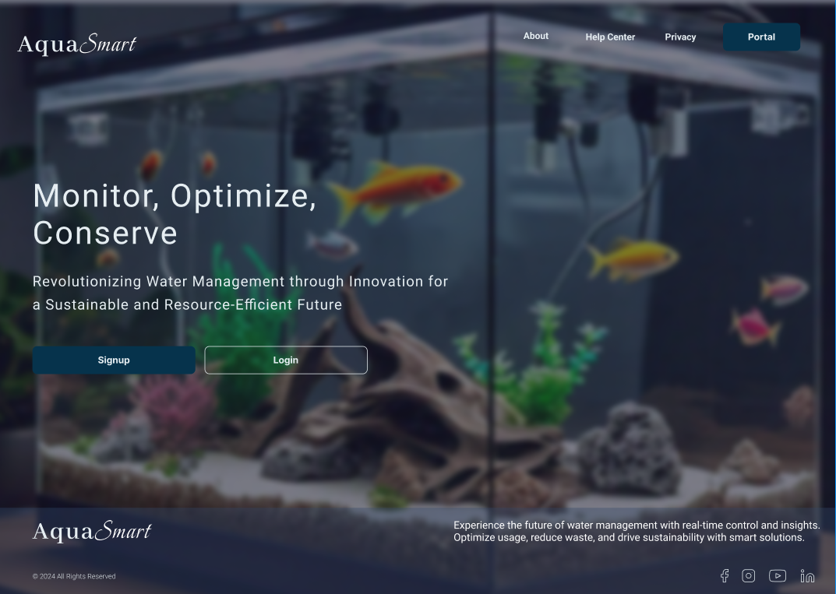
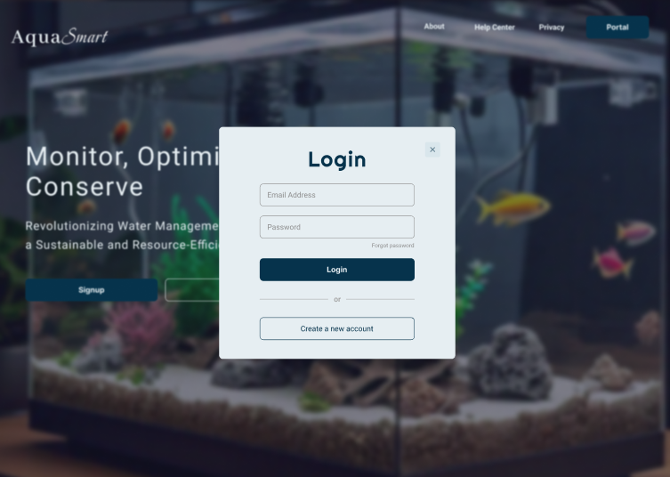
UI/UX
Fig 10: Frontend

Slide 17
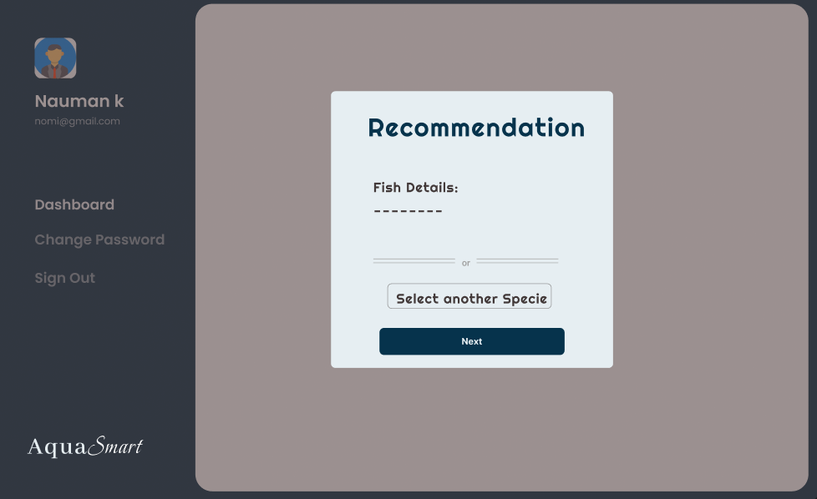
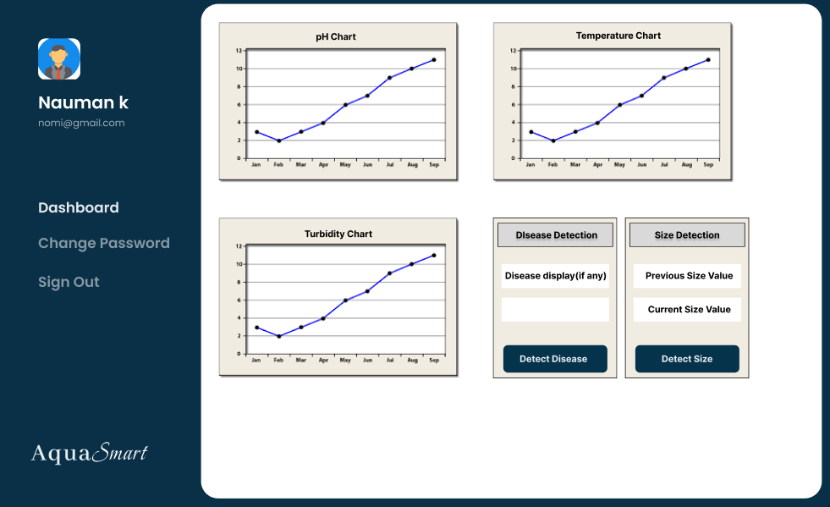
UI/UX
Fig 11: Frontend

Slide 18
Team Work
Sajid Ali
FYP 1: FYP 2:
Research fish species classification and develop AI/ML model for species selection. Implement continuous monitoring with real-time alerts for parameter fluctuations.
Gather system requirements for continuous monitoring of water parameters. Validate and optimize the classification model using real-time sensor data.
Muhammad Nauman
FYP 1: FYP 2:
Develop algorithms for continuous monitoring of water parameters, focusing on data analysis. Implement disease detection module using computer vision for image analysis.
Create user alerts based on sensor readings for necessary interventions. Create a notification system for detected diseases and treatment recommendations
Ammar Raza
FYP 1: FYP 2:
Design size monitoring module with camera integration for weekly assessments. Refine size monitoring algorithms for accurate assessments.
Set up backend structure and conduct initial system integration testing. Finalize user interface to integrate all modules (monitoring, size, movement, disease detection).

Slide 19
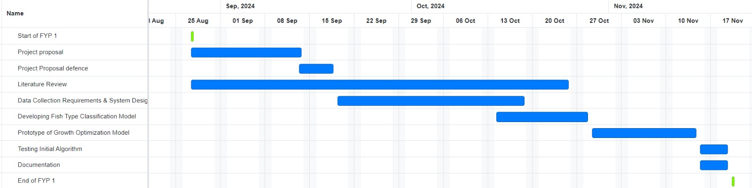
FYP 1 Gantt Chart
Fig 12: FYP-1 Gantt Chart

Slide 20
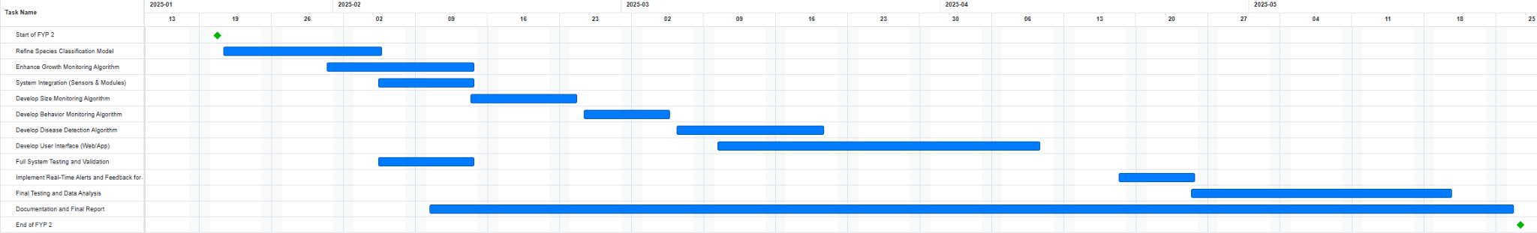
FYP 2 Gantt Chart
Fig 13: FYP-2 Gantt Chart

Slide 21
References
M. M. Hemal, A. Rahman, Nurjahan, F. Islam, S. Ahmed, M. S. Kaiser, and M. R. Ahmed, "An Integrated Smart Pond Water Quality Monitoring and Fish Farming Recommendation Aquabot System," Sensors, vol. 24, no. 3682, pp. 1-22, Jun. 2024.
K. S. B. Keerthi and R. Subhashini, "Tracking of Fish Behaviour Using Computer Vision and Deep Learning," Mathematical Statistician and Engineering Applications, vol. 71, no. 3s2, pp. 1635-1644, Jul. 2022​
G. G. Monkman, K. Hyder, M. J. Kaiser, and F. P. Vidal, "Using machine vision to estimate fish length from images using regional convolutional neural networks," Methods in Ecology and Evolution, vol. 10, pp. 2045-2056, 2019​
A. F. Abdullah, H. Che Man, A. Mohammed, M. M. A. Karim, S. U. Yunusa, and N. A. B. M. Jais, "Charting the aquaculture internet of things impact: Key applications, challenges, and future trend," Aquaculture Reports, vol. 39, 2024
M. Ahmed, M. O. Rahaman, M. Rahman, and M. A. Kashem, "Analyzing the Quality of Water and Predicting the Suitability for Fish Farming based on IoT in the Context of Bangladesh," presented at the 2019 International Conference on Sustainable Technologies for Industry 4.0 (STI), Dhaka, Bangladesh, Dec. 2019​
A. Rodriguez, A. J. Rico-Diaz, J. R. Rabunal, J. Puertas, and L. Pena, "Fish Monitoring and Sizing Using Computer Vision," in Lecture Notes in Computer Science, vol. 9108, J. M. Ferrández Vicente et al., Eds. Cham: Springer, 2015, pp. 419-428
A. Waleed, H. Medhat, M. Esmail, K. Osama, R. Samy, and T. M. Ghanim, "Automatic Recognition of Fish Diseases in Fish Farms," Faculty of Computer Science, Misr International University, Cairo, Egypt​
R. Law, "Fishing, selection, and phenotypic evolution," ICES Journal of Marine Science, vol. 57, pp. 659–668, 2000

